Slide 1


Arduino IDE
Installation and Basic Setup

Slide 2
Introduction to Arduino IDE
What is Arduino IDE?
Importance of Arduino IDE in programming microcontrollers.
Platforms supported: Windows, macOS, Linux.

Slide 3

What is Arduino IDE?
Arduino IDE (Integrated Development Environment) is the official software used to write, compile, and upload code to Arduino boards.
It provides a simple and user-friendly interface for programming microcontrollers, making it accessible to beginners and professionals alike.
The Arduino IDE primarily uses C and C++, making it easy to understand and adapt for embedded systems.

Slide 4
Importance of Arduino IDE in Programming Microcontrollers
User-friendly interface for coding.
Pre-built libraries simplify coding for sensors and components.
Built-in serial monitor for debugging.
Supports multiple Arduino boards (Uno, Nano, Mega, ESP32, etc.).

Slide 5
Platforms Supported by Arduino IDE
Windows (Windows 7, 8, 10, 11).
macOS (10.10 or later).
Linux (Supports AppImage and terminal-based installation).

Slide 6
How to Install Arduino IDE
Visit the official website: https://www.arduino.cc/en/software
Download the correct version for your OS (Windows/macOS/Linux).
Install the software and allow required drivers.

Slide 7
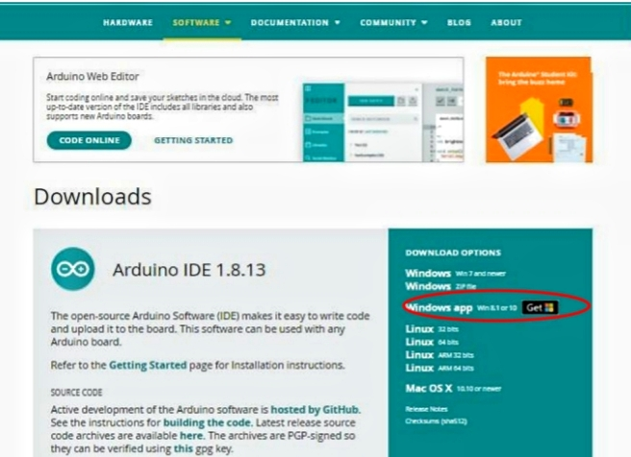
Installation Page of Arduino IDE

Slide 8
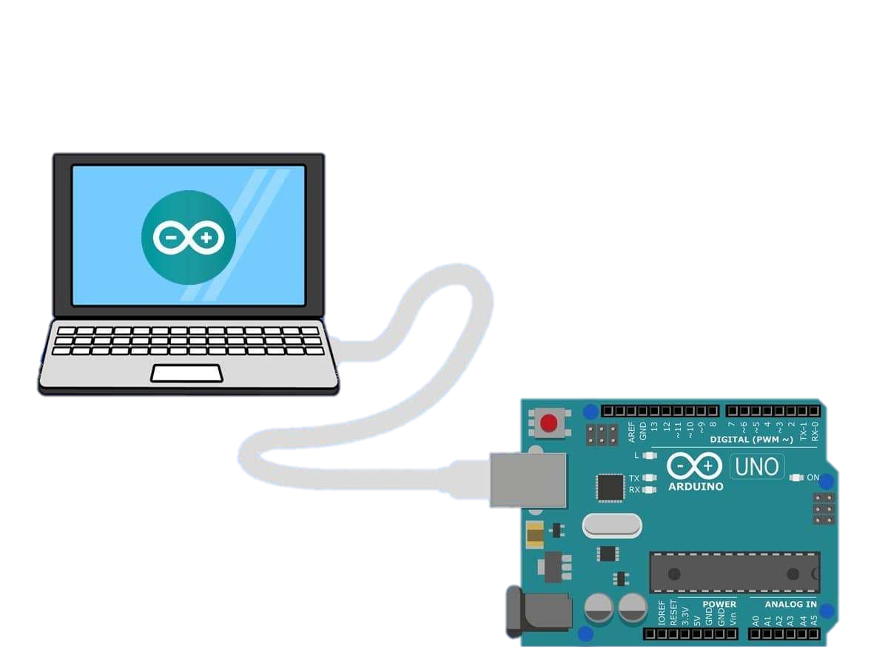
Connecting Your Arduino Board
Use a USB cable to connect the Arduino board to your PC.
Windows users may need to install additional CH340 drivers.
Ensure the board is detected under Device Manager.

Slide 9
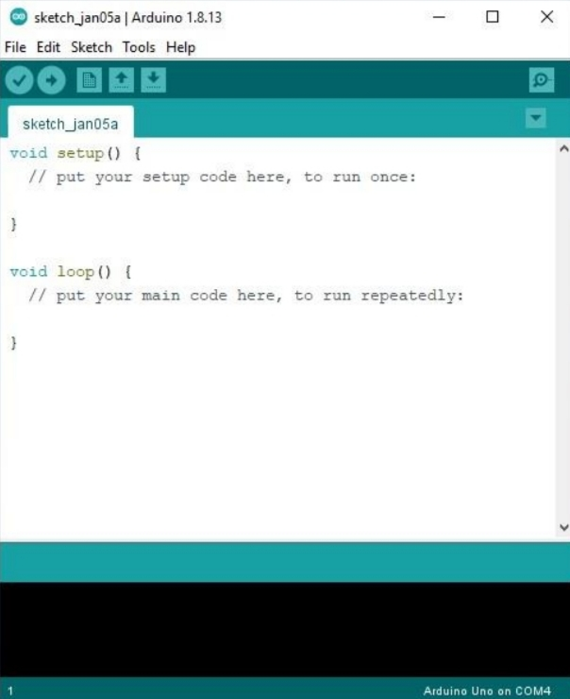
First Demo Sketch Code

Slide 10
Writing and Uploading Code
Open Arduino IDE and go to File > New to create a new sketch.
Select the correct Board and Port from Tools.
Write a simple LED blinking program and upload it.

Slide 11
Example: Blinking LED
void setup()
{
pinMode(13, OUTPUT);
}
void loop()
{
digitalWrite(13, HIGH); delay(1000);
digitalWrite(13, LOW); delay(1000);
}

Slide 12
Troubleshooting Common Issues
Port Not Found – Check cable and try reconnecting.
Upload Error – Ensure the correct board and port are selected.
Compilation Issues – Verify the syntax and install missing libraries.

Slide 13
Additional Features in Arduino IDE
Serial Monitor – Displays sensor data and debugging output.
Library Manager – Allows easy installation of external libraries.
Code Auto-format – Formats messy code for better readability.

Slide 14


